Slide 1



Slide 2
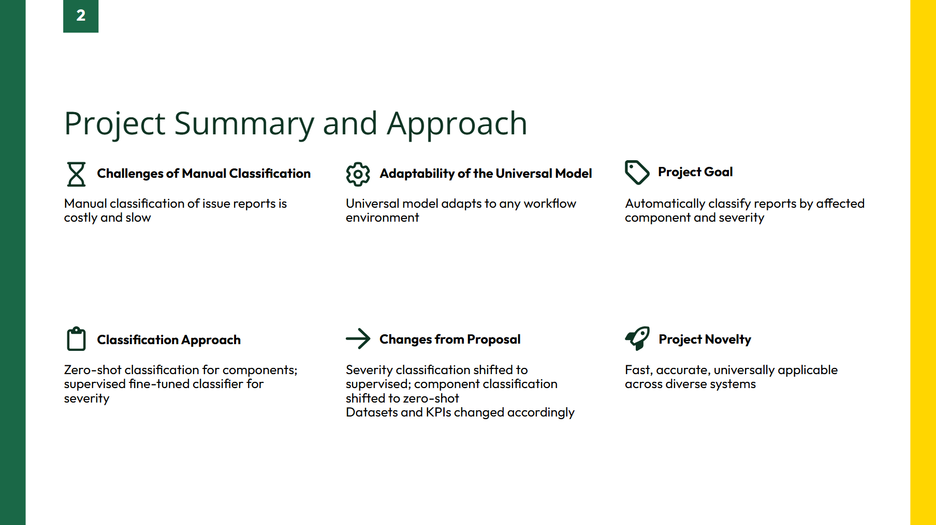

Slide 3
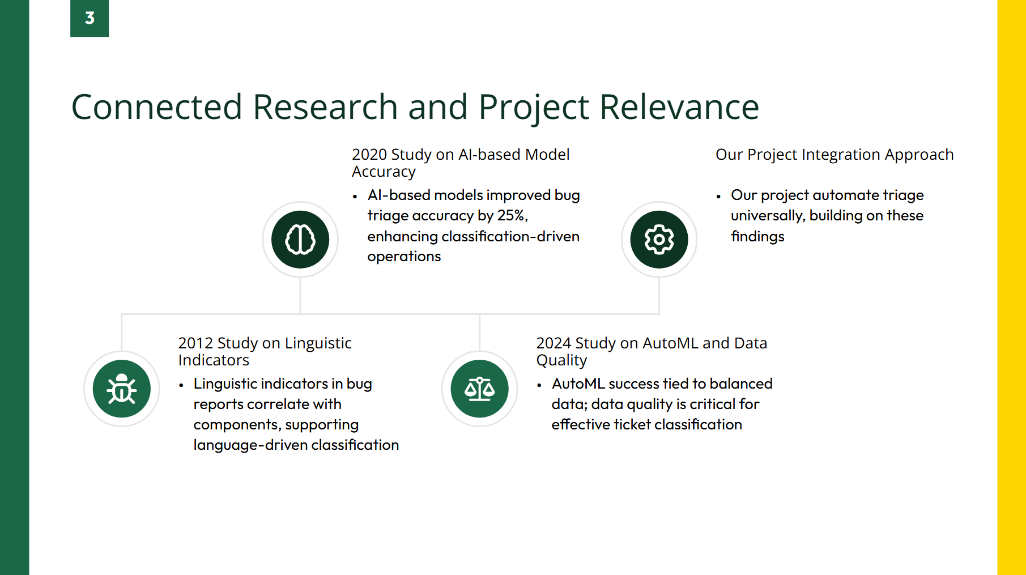

Slide 4
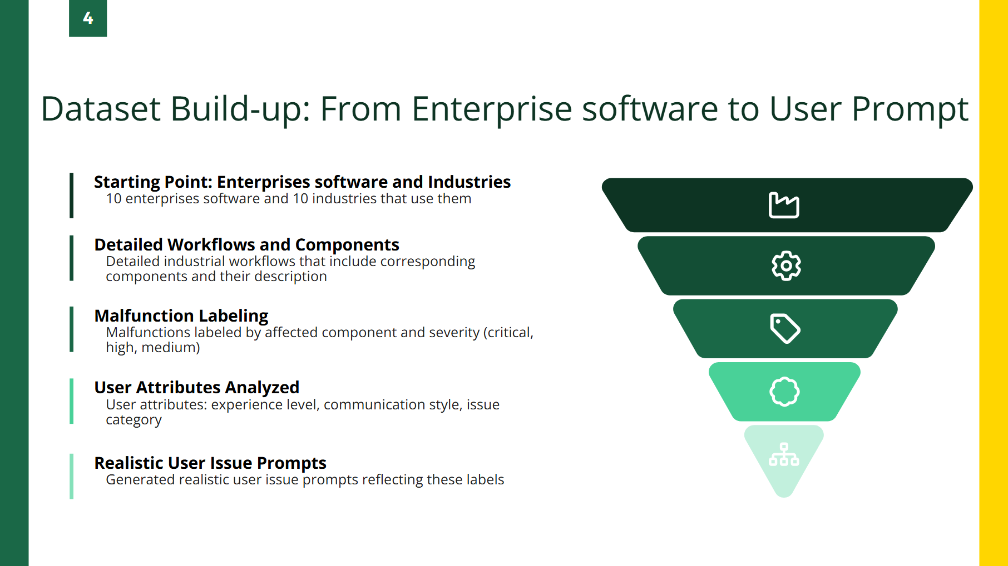

Slide 5


Enterprise software system
BI (business intelligence):
Business Intelligence system for analyzing and presenting complex data
Industries
Agriculture:
Field involved in cultivating land, raising crops, and rearing livestock for food, fiber, biofuel, and other products.
Workflow
BI System in Agriculture Industry:
This workflow involves the use of a Business Intelligence (BI) system in the Agriculture industry for analyzing and presenting complex data to make informed business decisions related to cultivating land, raising crops, and rearing livestock for food, fiber, biofuel, and other products.
Component
Data Warehousing:
Stores and organizes large volumes of structured and unstructured data related to crop yields, weather patterns, soil quality, market prices, and livestock health for analytical purposes.
Reporting and Dashboarding Tool:
Enables the creation of visual representations, reports, and dashboards to provide insights into key performance indicators (KPIs) such as crop productivity, market demand, and resource utilization

Slide 6
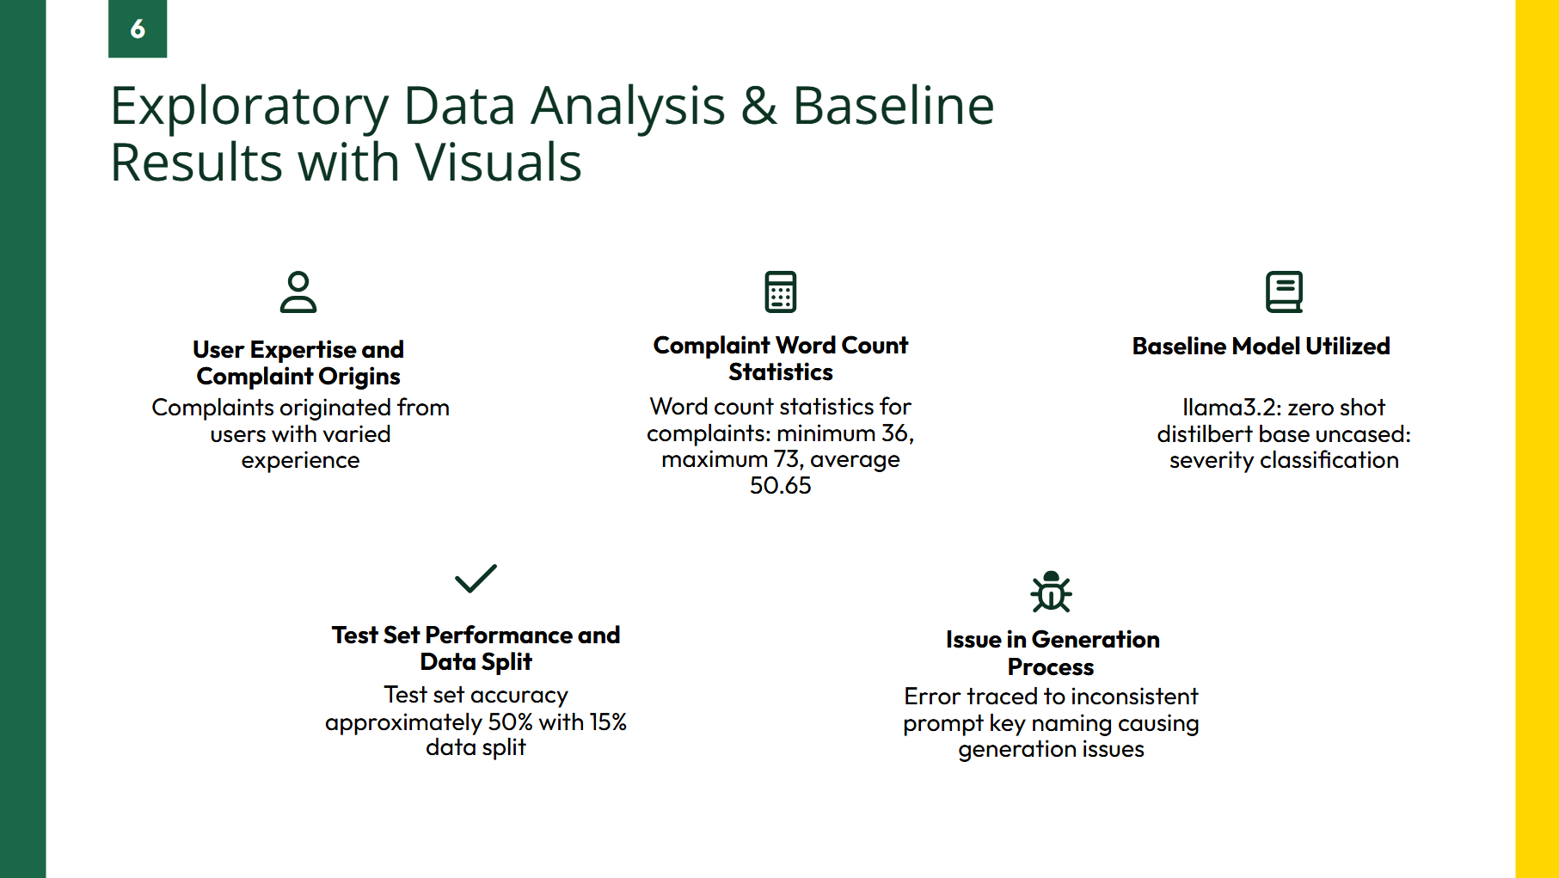

Slide 7
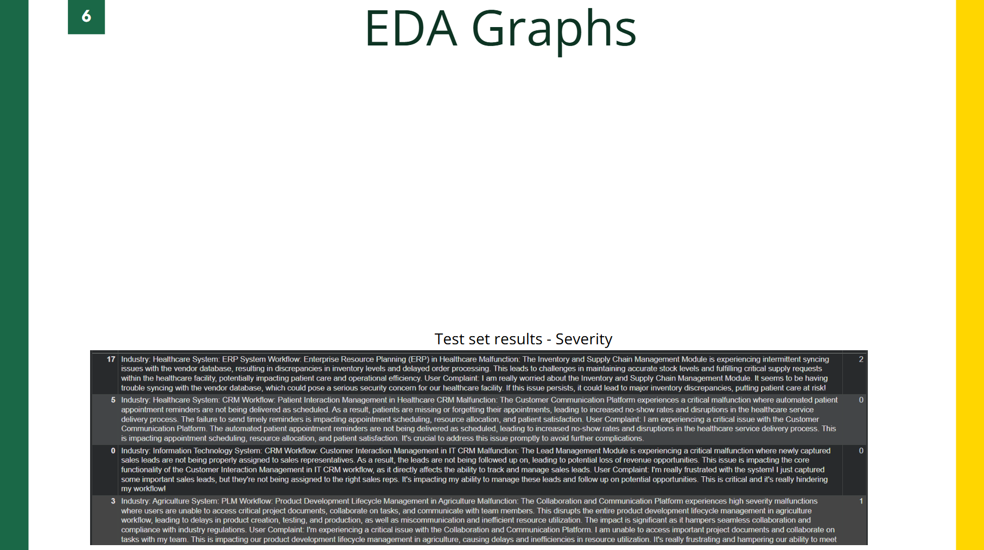
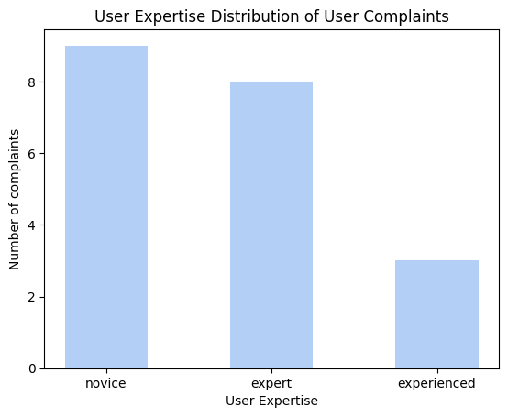
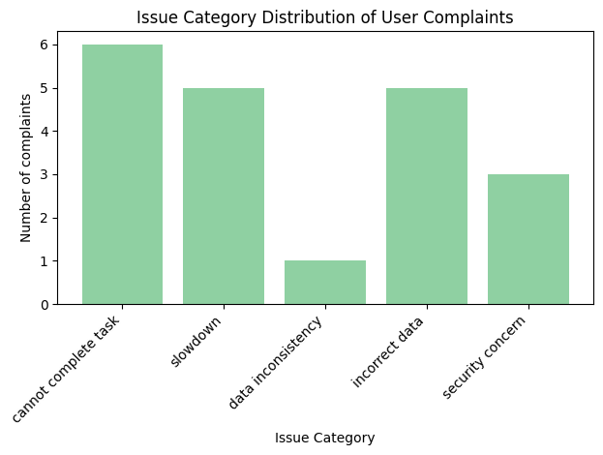
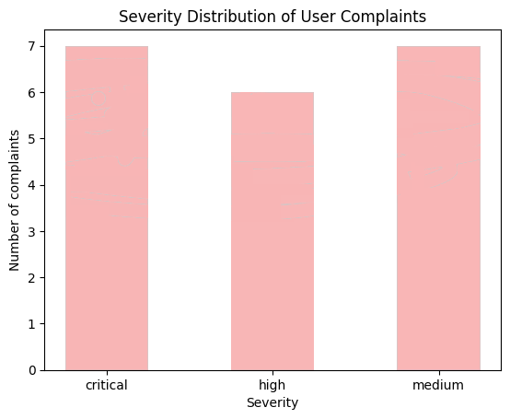

Slide 8
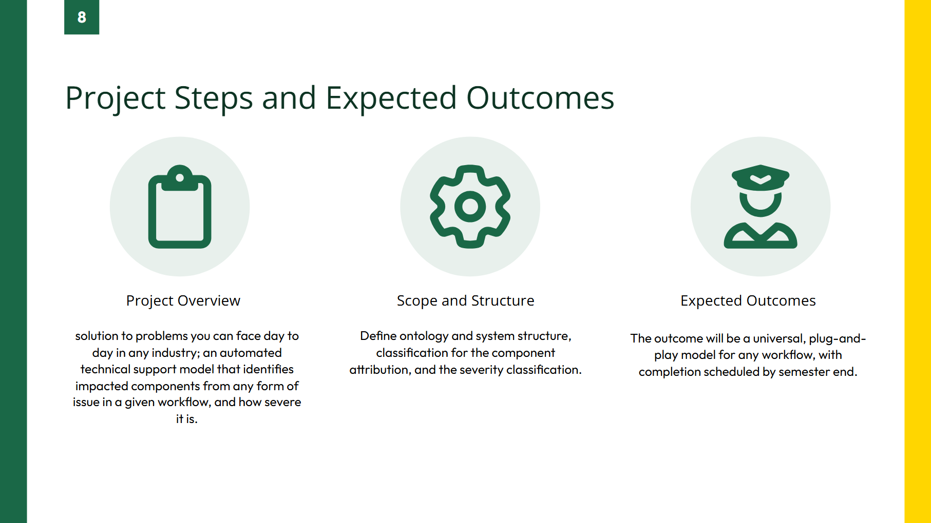

Slide 9
